Slide 1
Node

Slide 2
What is Node.js?
Open source & cross-platform project.
Build on Chrome's JavaScript runtime environment.
Event driven & Non-blocking IO.
Real time apps.
Single threaded.
Build in Async IO, HTTP/s, file-system etc.
Ability to do JavaScript on server.
Act as a web server.

Slide 3
JavaScript Engine
Computers do not understand javascript.
A javascript engine takes javascript, and convert it into something it does understand-machine code
Nodejs is written in C++
At the heart of node js is V8
The V8 engine converts our JS into machine code

Slide 4
V8 JavaScript Engine
Javascript
C++ Nodejs
V8
Machine Code

Slide 5
Why Server-side JavaScript?
You write JavaScript (A well known language)
You can share code between the client and server-side
Running on-top of V8 (which is extremely fast)
Asynchronous model (a ton of compatible modules to help you)
Friendly callbacks
Ubiquitous
No I/o Primitives
One language to RULE them all

Slide 6
Blocking vs Non-Blocking Code

Slide 7
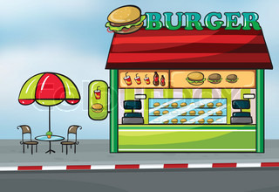

Blocking vs Non-Blocking Code
Hi my name is Apache.How may I take your order?

Slide 8
Blocking vs Non-Blocking Code
Hmm… still thinking….

Slide 9
Blocking vs Non-Blocking Code
OMG He’s blocking. I could have ordered by now
Hmm… still thinking….

Slide 10
Blocking vs Non-Blocking Code
The more customers you want to serve at once, the more customers lines you’ll need.
Multiple customers line ~ threads in computing
Multi-threaded processing
Parallel code execution
Multiple CPUs run at a time, utilizing shared resources (memory)

Slide 11

Blocking vs Non-Blocking Code
I’m still
thinking,but callback to me when I am done
While he’s thinking, I’ll order the salmon

Slide 12
Blocking vs Non-Blocking Code
Node loops through the customers and polls them to determine which ones are ready to order.
During a function’s queue, Node can listen to another event.
When the other customer is finally ready to order, he’ll issue a callback.
Asynchronous callbacks: “come back to me when I’m finished”
function called at the completion of a given task.

Slide 13
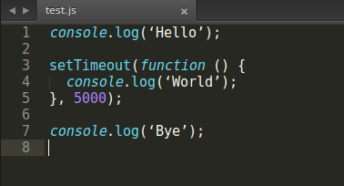
Blocking vs Non-Blocking Code
Output:-
Hello
Bye
World
Allows for high concurrency

Slide 14
Blocking vs Non-Blocking Code
Every function in Node is non-blocking
Single-threaded
No parallel code execution
Single CPU

Slide 15
Nodejs Architecture

Slide 16
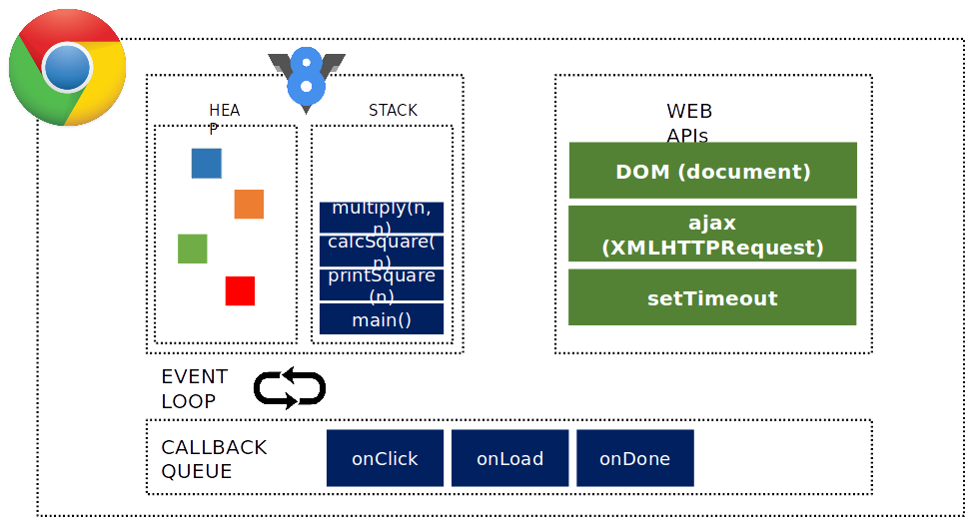
JavaScript Event Loop

Slide 17
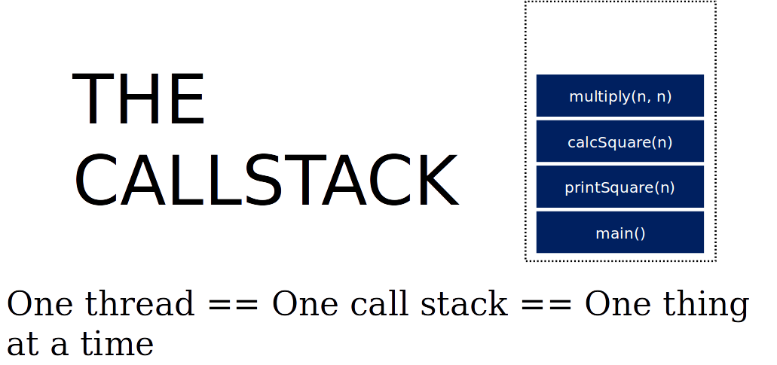
JavaScript Event Loop

Slide 18
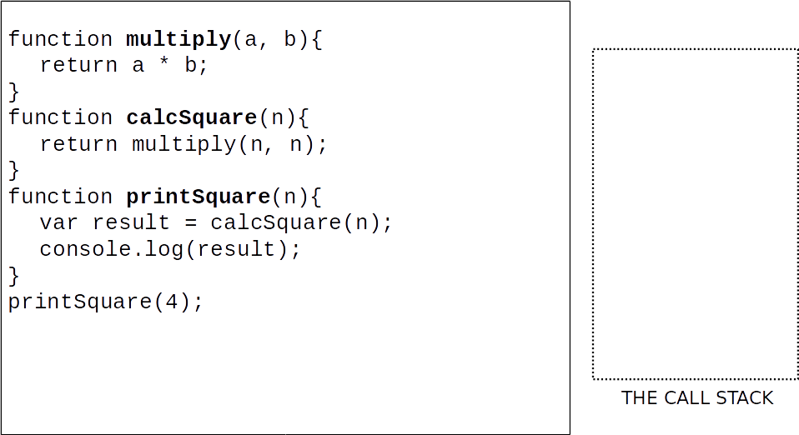
JavaScript Event Loop

Slide 19
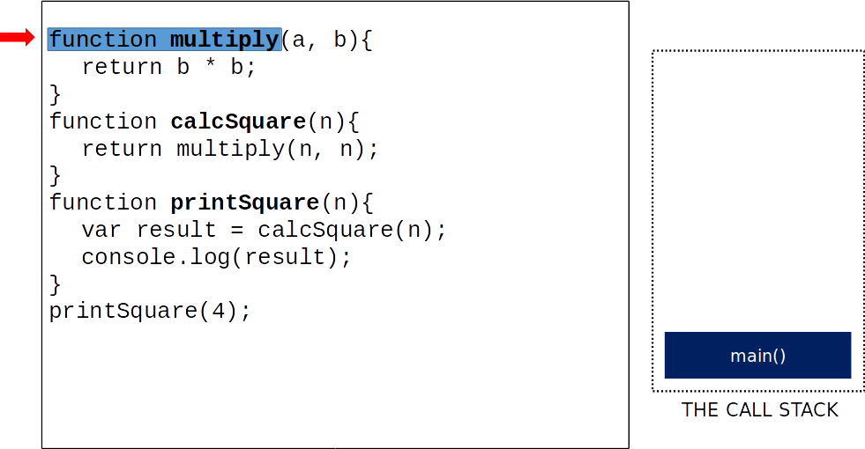
JavaScript Event Loop

Slide 20
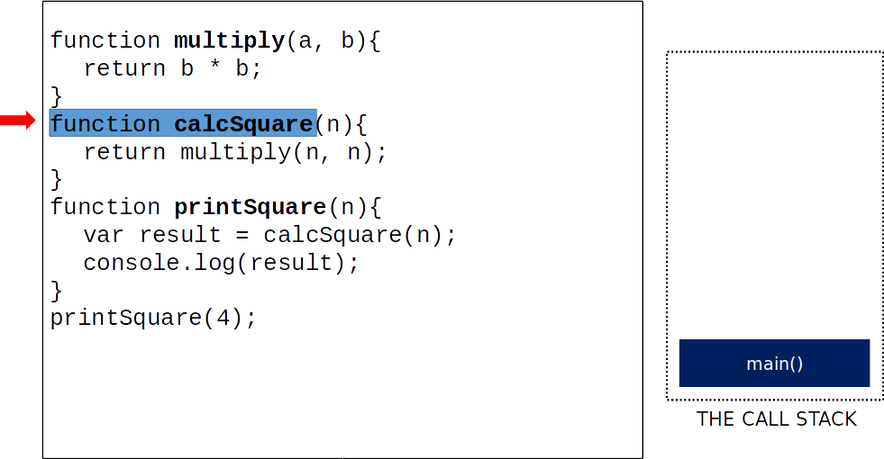
JavaScript Event Loop

Slide 21
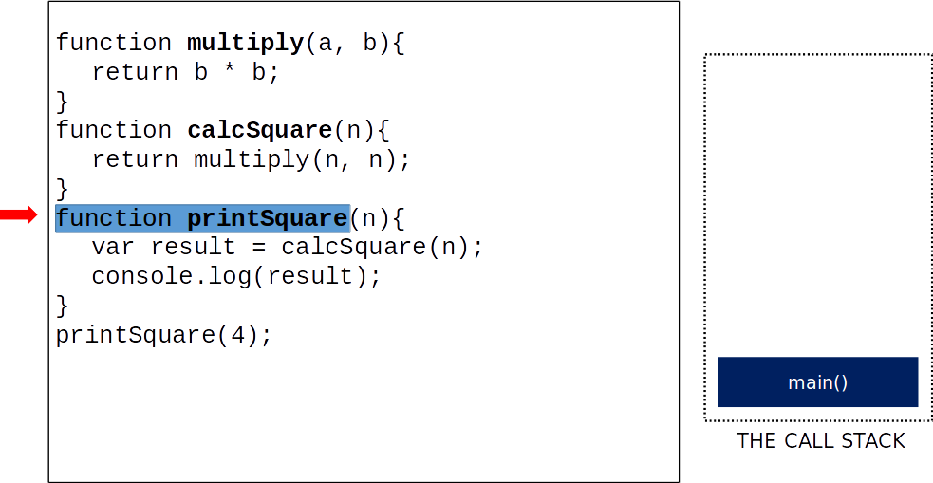
JavaScript Event Loop

Slide 22
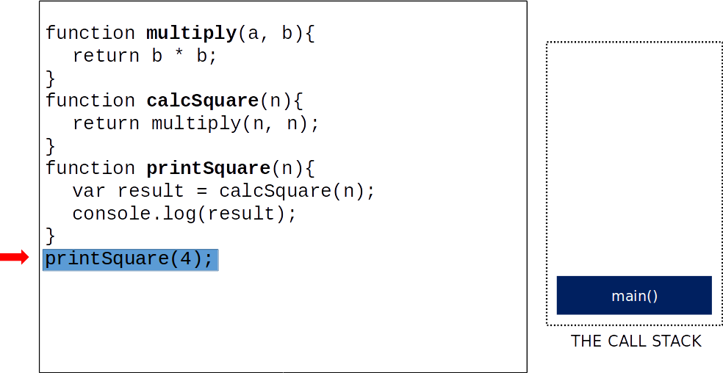
JavaScript Event Loop

Slide 23
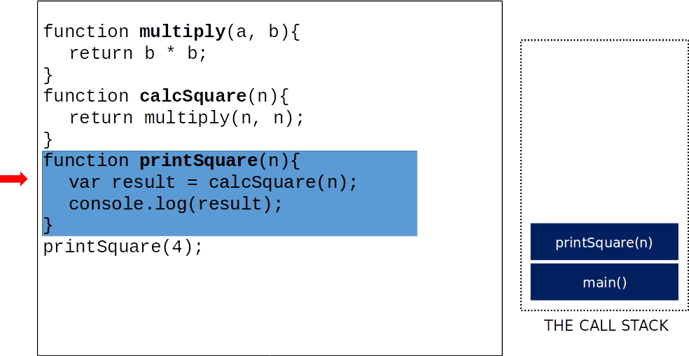
JavaScript Event Loop

Slide 24
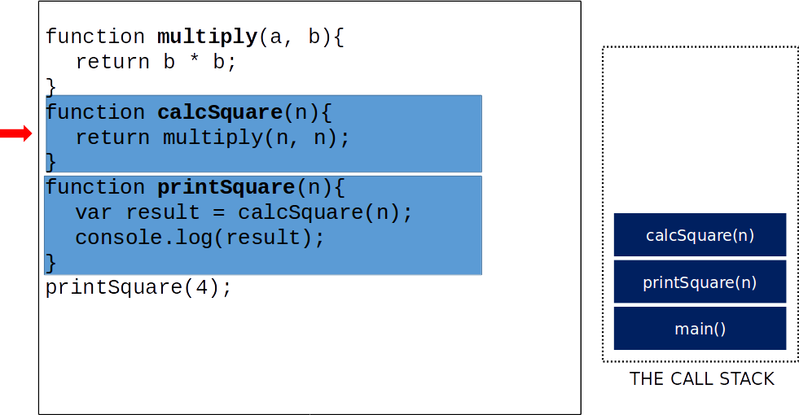
JavaScript Event Loop

Slide 25
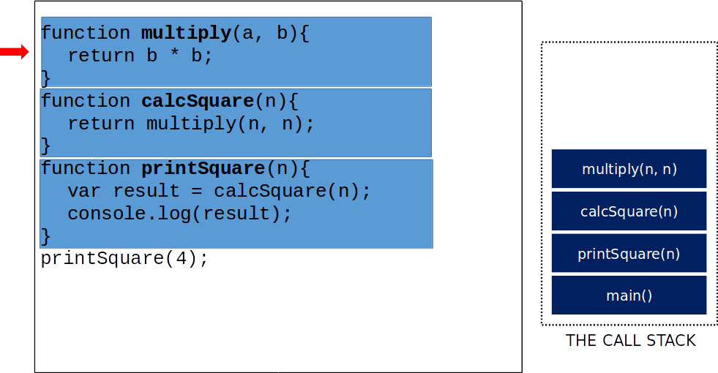
JavaScript Event Loop

Slide 26
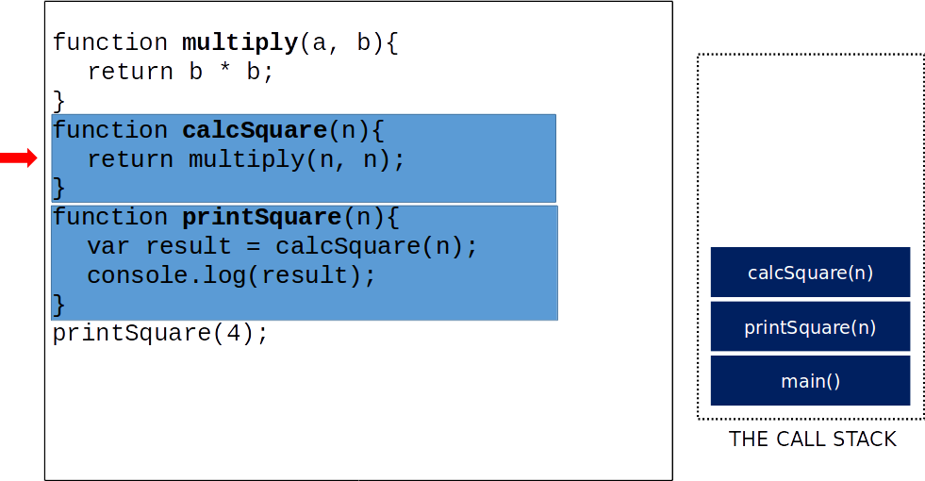
JavaScript Event Loop

Slide 27
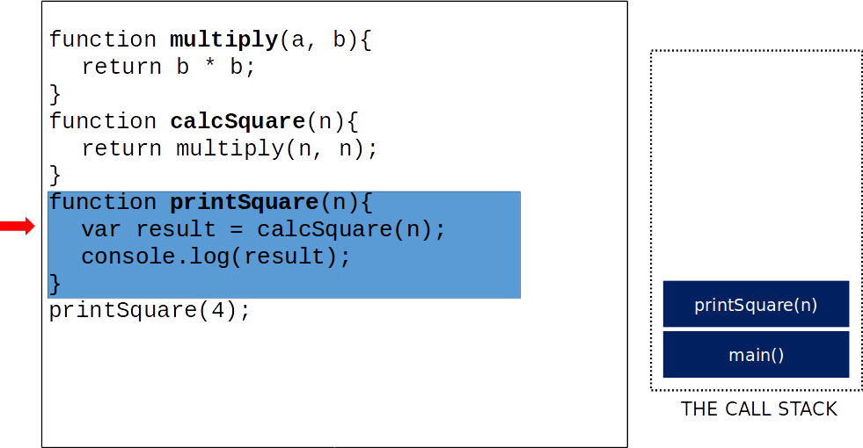
JavaScript Event Loop

Slide 28
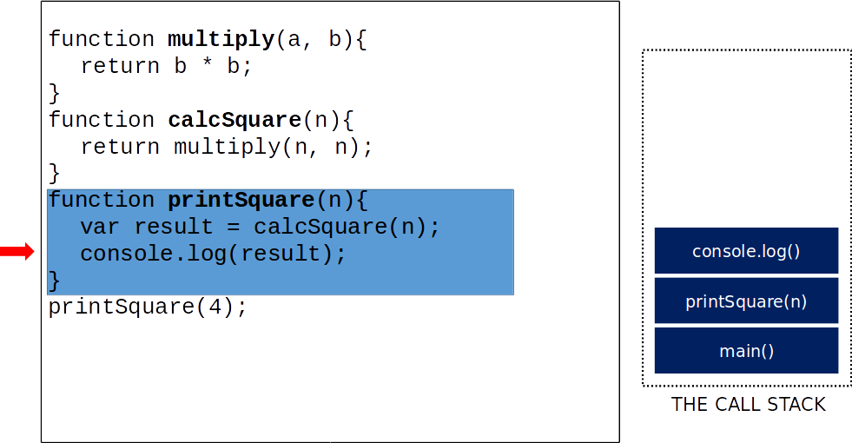
JavaScript Event Loop

Slide 29

JavaScript Event Loop

Slide 30
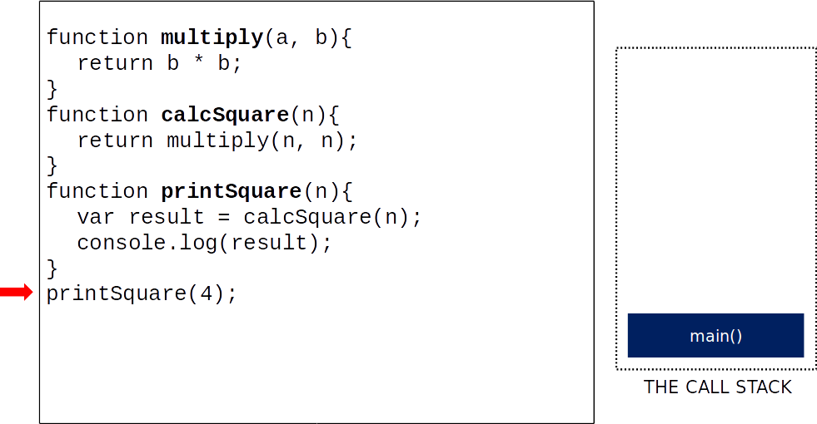
JavaScript Event Loop

Slide 31

JavaScript Event Loop

Slide 32
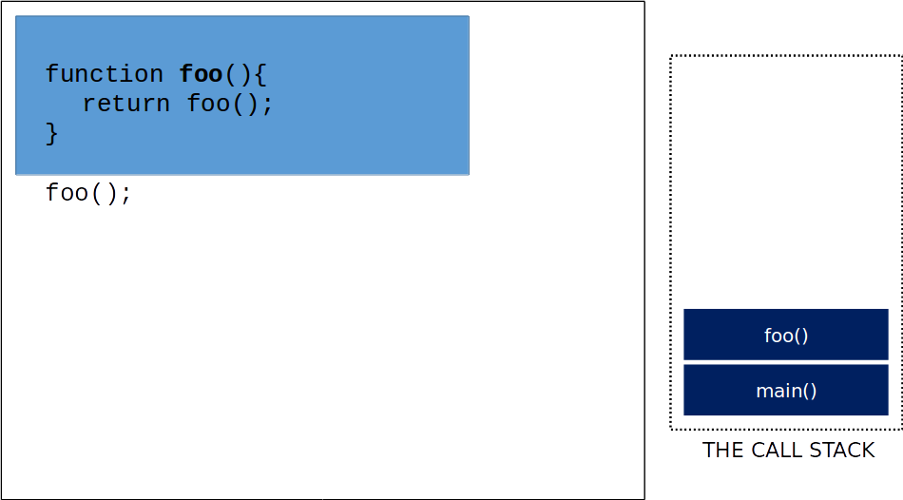
JavaScript Event Loop

Slide 33
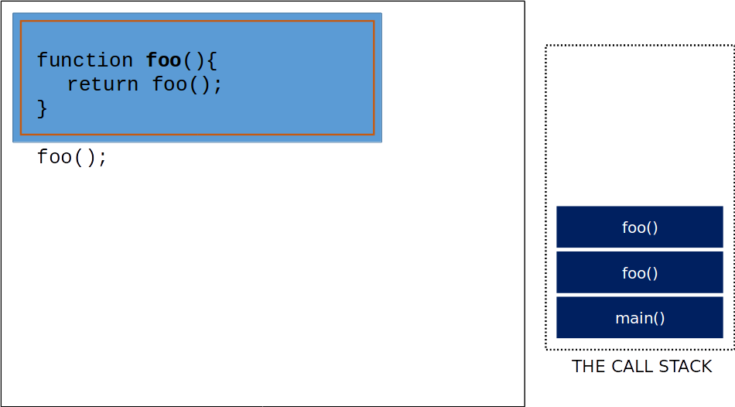
JavaScript Event Loop

Slide 34
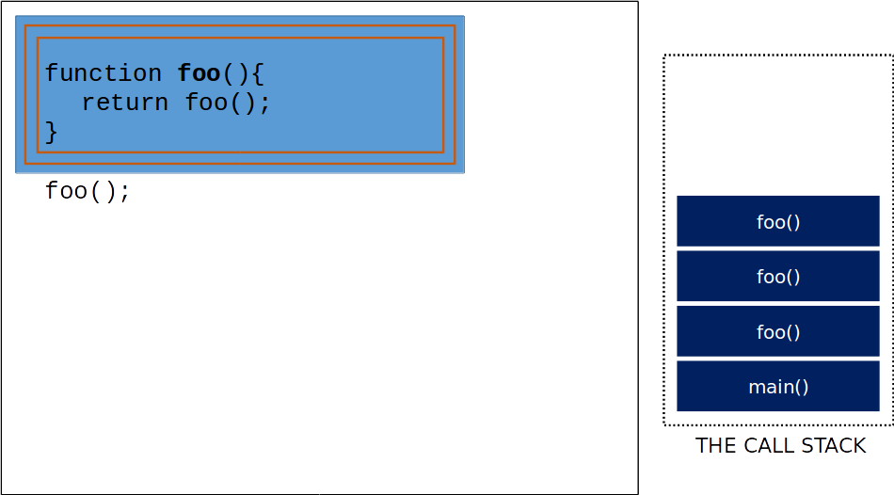
JavaScript Event Loop

Slide 35
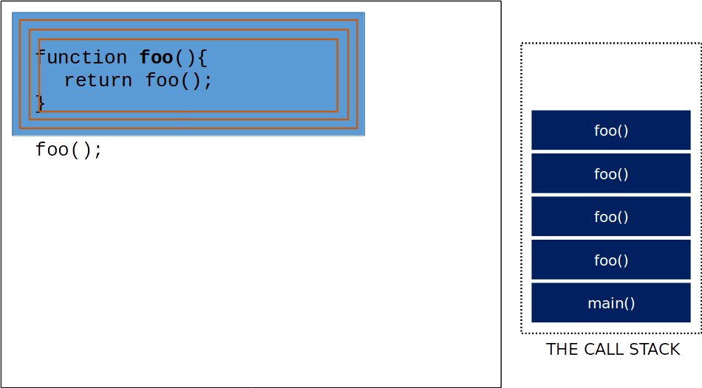
JavaScript Event Loop

Slide 36
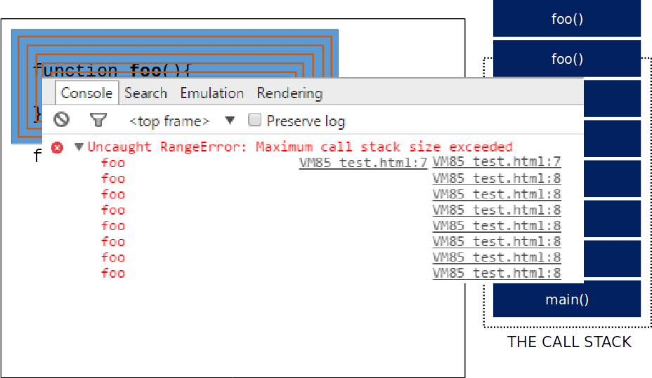
JavaScript Event Loop

Slide 37
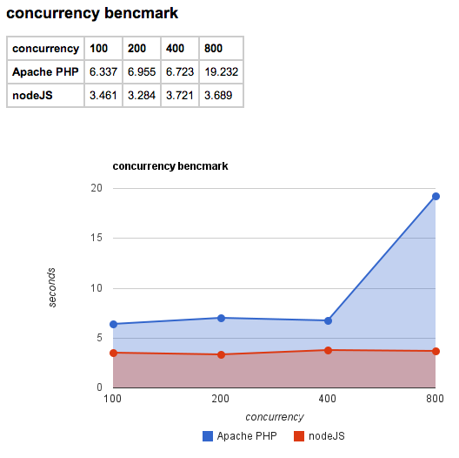
Node.js vs. others Server Side Frameworks

Slide 38
Node.js vs. others Server Side Frameworks
Node is great for applications with high concurrency
(Concurrency = number of concurrent clients or users)

Slide 39
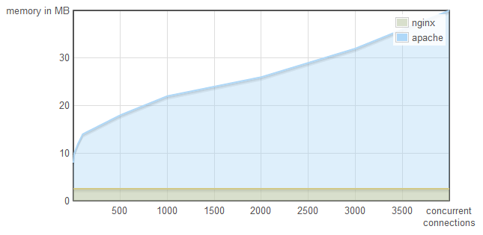
Node.js vs. others Server Side Frameworks
nginx: non-blocking I/O
apache: blocking I/O

Slide 40
Where Node can be the best solution
Here are few applications or areas where Node.js can be the best solution.
Websocket Server
The non-blocking architecture of node makes it the best suited solution for socket server applications or broadcasting like applications.
Chat servers can become more efficient and real time using Node.js as their base.
Fast file upload client
With node you can upload multiple files at a time.
That means it is possible that a part of file1 and another part of file2 is in the server at a given point of time.
This approach makes file uploading dramatically fast.

Slide 41
Where Node can be the best solution
Data streaming
As node deals with callback concept, it can easily be used for streaming data flow.
It can be really useful for Travel industry where they fetch results from different APIs of different suppliers.
Ad server
Well, I personally think Ad servers should be the fastest servers.
Because, from a advertiser’s point of view, if I can load the ads before all the contents of the page is loaded, I may catch the visitor.
Another is if my ads load slower, the visitor might navigate to somewhere else.
So ad servers really need to be fast and thus Node should be used.

Slide 42
Where Node can be the best solution
Stock exchange software
Things has to be very much real time in case of stock updates.
Node helps us to develop real time web applications.

Slide 43
When should you use Node?
Use Node when:
cost of I/O > cost of more difficult to write code.

Slide 44
Limitations of Node.js
It doesn’t support multi-threaded programming.
It doesn’t support very high computational intensive tasks. When it executes long running task, it will queue all the incoming requests to wait for execution, since it follows JavaScript event loop which is single threaded.
Not useful for when I/O is light, CPU usage is high (e.g., video encoding software)

Slide 45
Companies using Node.js.
NETFLIX
PAYPAL
UBER
IBM
MICROSOFT

Slide 46
Conclusion
Node.js came up with a new idea of event driven single threaded server programming which is achieved with callback concept.
With the growing demand and popularity of JavaScript, a step to reach the server side or backend programming is really appreciable and it also raise hope to lots of JS developers.
But at this moment, if we say Node is strong enough to replace .NET, PHP or JAVA it will be a hyperbole.
But yes, the way JavaScript is developing, we are very hopeful that one day Node may become an ultimate solution for the web backend.

